Slide 1
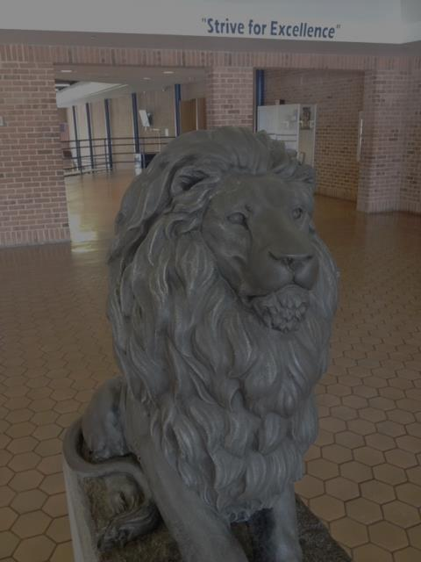
Navigating Your Path to Graduation
Liberty High School
January 2018
Notes:
Goal of evening: help students and parents learn about high school to gain understanding and ease stress
Transition process- can be difficult- important to know resources,
spring visit, orientation/ back to school night in August
plan to get involved (sports, music, drama, clubs)

Slide 2
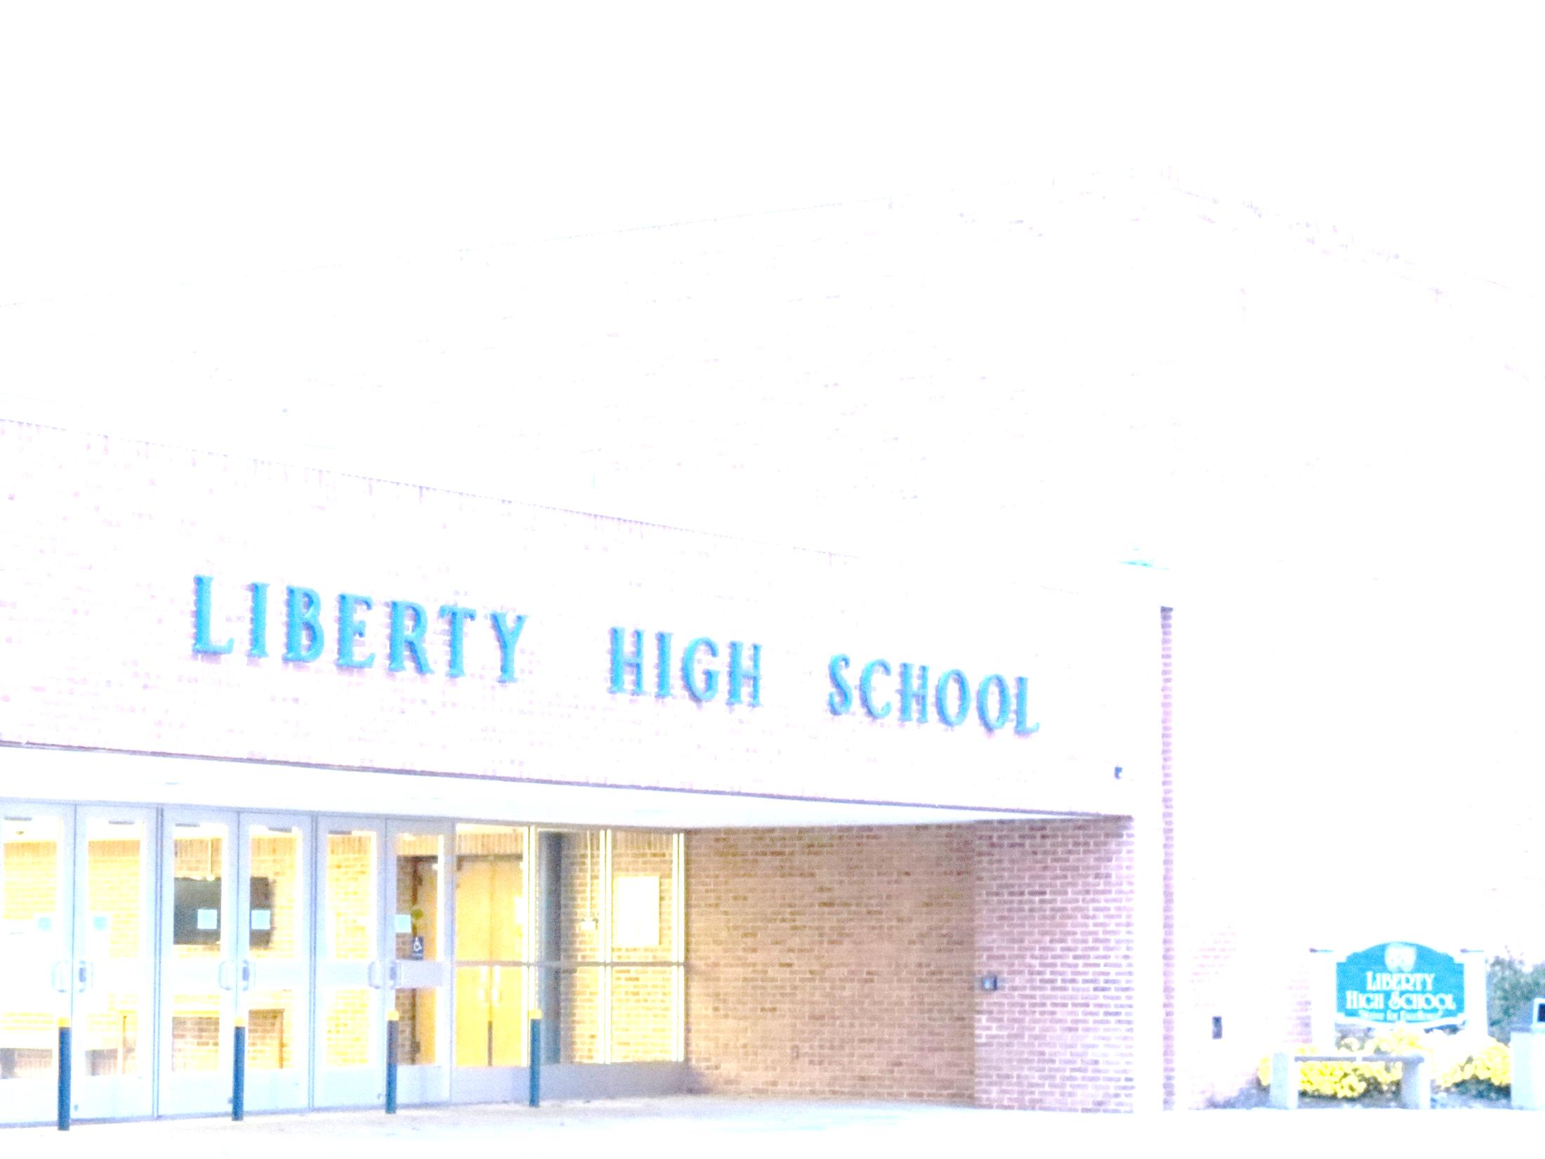
Welcome to Liberty High School
Class of 2022!
Strive for Excellence!

Slide 3
Who’s Who at Liberty?
Principal- Mr. Goncz
Assistant Principal (A-K)- Mrs. Martin
Assistant Principal (L-Z)- Mrs. Brown
Academic Facilitator/ STC- Mr. Tombs
Counselor (A-E)- Mrs. Hamilton
Counselor (F-K)- Mrs. Taylor
Counselor (L-Q)- Mr. Putt
Counselor (R-Z)- Ms. Cattrano
Career Coordinator – Mrs. Trump
Athletic Director- Mr. DeVincent
Notes:
Introduction of Administrators and Counselors
Strive for excellence- preparing students for college and career
Notes: AP offering for freshmen (50 recommended)
Reading instruction- working with ORMS reading specialist to contact parents to recommend reading. Our reading specialist will be available on both conference nights.

Slide 4
Graduation Requirements
Notes:
Earning credits- each class = credit or ½ credit. 25 are needed to graduate from CCPS. All classes are reported on transcript. Weighted GPA versus unweighted GPA.
Please use the Program of Studies to guide you (on weebly, will show later)

Slide 5
Graduation Requirements
Core Courses
Additional Courses
English
Physical Education
Math
Health
Social Studies
World Languages
Science
Tech Ed/Computer Science
Other
Fine Arts
State Testing
Financial Literacy
Service Learning
Electives
Notes:
Classes in content areas
Service learning- encouragement to finish them in middle school. 55 to be a senior. SLH are reported on transcripts. More can be helpful in admissions and scholarships.
Testing- H.S.A in Biology and Government. Must take PARCC in Algebra I, English 10, and Algebra II. Still learning about requirements for graduation.

Slide 6
Graduation vs. CCR
Graduation Requirements- passing required for graduation | College & Career Readiness Requirements
PARCC: English 10 Algebra I H.S.A.: Government MISA: Physics, Chemistry, Biology | PARCC: English 11 Accuplacer: Algebra II Reading and Language (grade 12) Other: AP, SAT, ACT, CTE Certification
Notes:
Slide 10: Here is the break down of which test and class relate to graduation requirements and which relate to College and Career Readiness. As you can see, the CCR courses are upper level courses. If students are unsuccessful with the CCR Requirements, we will offer opportunities for remediation and retesting during the following year. Students must take and pass the graduation requirements. If qualifying scores for CCR are in place (i.e. SAT, AP, etc.), a student may opt out of a test. However LHS strongly encourages students to take PARCC 11 and Accuplacer due to its highly rigorous content and standardized feedback. Scores assist in providing LHS in instruction tools and gaging our performance. Determining CCR can be based on several indicators: see chart for indicators for English and Math. CCPs has not made a final determination if or how students will be formally designated as College and Career Ready.
Stay turned for another parent night for more information on College and Career Readiness and testing requirements.

Slide 7
College and Career Readiness
The Maryland College and Career Readiness and College Completion Act of 2013 requires that all students in grade 11 complete an assessment to determine if they meet the criteria set forth by MSDE for college and career readiness.
CCR is defined as:
1. The level of preparation a student needs to enroll and succeed, without remediation, in a credit-bearing course at a postsecondary institute.
2. in a high quality certificate program that enables students to enter a career pathway with potential future advancement.
Notes:
Slide 9: One of the many goals of high school is to prepare students to be “college and career ready” by preparing them for college level course as well as identifying career pathways.

Slide 8
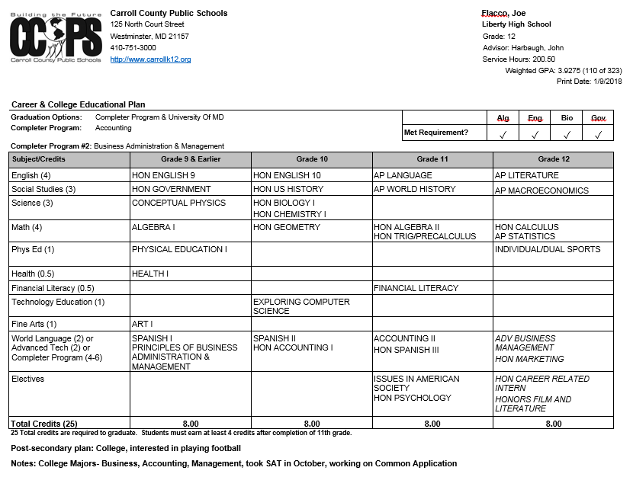
Educational Career Plan
Notes:
Individualized plan created with counselors and advisors meet with students each year to discuss their goals.
Can be updated and changed.
Helps to plan prerequisite courses for upper level classes, completer programs, internships. Tracks graduation requirements.
Will be the start of the scheduling process in future years.

Slide 9
Completer and Career Major Programs
Completer Program- A completer is a specific series of courses in a specialized career area. Completer programs are available at the Career and Technology Center and/or home high schools.
Examples of Completer Programs: Accounting, Honors Marketing, CASE-Animal, Wildlife/Natural Resources, Early Childhood Education, Teacher Academy of Maryland, Print Production/Video Production, Project Lead the Way (Engineering), Academy of Health, Masonry, Cosmetology, Auto/Diesel, Homeland Security—Criminal Justice, Computer Networking, and MORE!
Career Major- A major is a series of courses in a specialized career cluster offered in the building here at LHS. There are 31 different majors in a variety of career paths. A minimum of 4 credits of specified cross-curricular work constitutes a career major.
Examples of Career Majors: Social Work, Law & Legal Services, Sports & Recreation, Visual Fine Arts, Drama, History, Physical Science, Life Science, Mass Communication, Food & Nutritional Services, Environmental Health, Actuarial Science, Economics, and MORE!

Slide 10
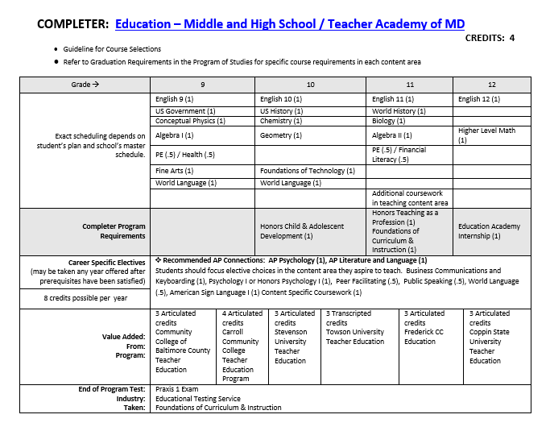
Example of a Completer Program- Regional Program
Take these four credits

Slide 11
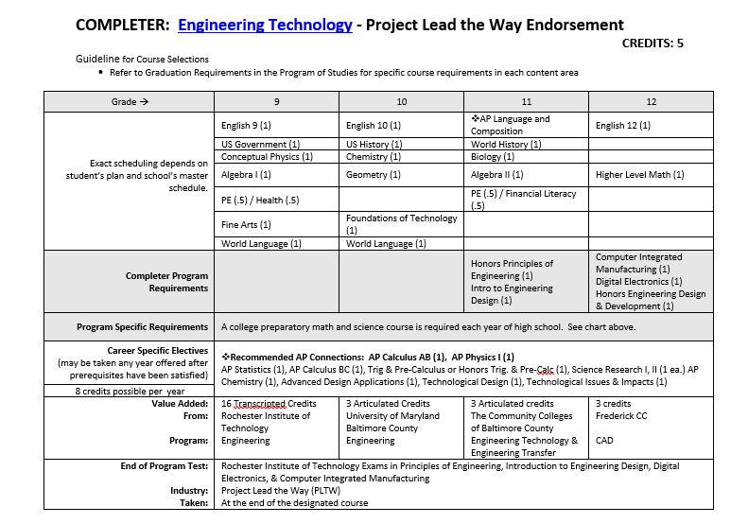
Example of a Completer Program- Career and Technology Center
Take these four credits

Slide 12
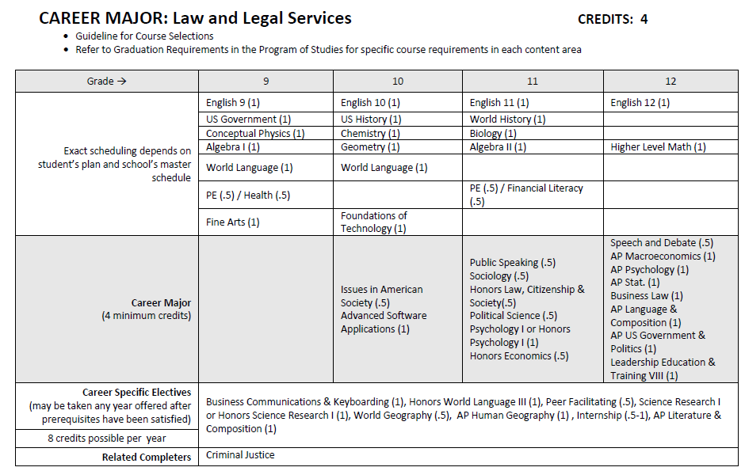
Example of a Career Major Program
Take four credits from
the shaded area

Slide 13
Sample 9th Grade Schedule
Mod | Semester 1 (Sept-Jan) | Semester 2 (Feb-June)
1 7:30-8:50 | Hon Physics | Hon Government
ADV 8:55-9:30 | ADVISORY/PAWS | ADVISORY/PAWS
2 9:35-10:55 | Health/ Physical Education | Hon Algebra I
3 11:00-12:55 Includes 30 minute lunch | Spanish II | Hon Chemistry I
4 1:00-2:20 | English 9/Band | English 9/Band
Notes:
Explain semester courses and ½ credit courses
Explain how GPA is calculated after earned credit
Explain balance in schedule
AP courses typically run on a yearlong schedule.

Slide 14
build relationships
provide students with a unique advocate
advisory
promote academic and personal success
Notes:
Students are grouped by last name into advisory groups. Goal is to build relationships. Advisories stay together through high school. Grade level lessons by age appropriate themes
Discuss PAWS- similar to Flex time

Slide 15
PAWS and peer tutoring
After school tutoring
Support Room
Parent teacher conferences- October and March
student support
Home Access Center

Slide 16
consider your interests and career ideas
selecting courses
course load and rigor
Notes:
Pay attention to their teacher recommendations- ask current teacher for questions on recommendation
Colleges looking for academic success- take courses at your academic level. Try to increase rigor over time.
Grades earned starting in freshman year factor into cumulative GPA, start strong
College planning is a 4 year process, start thinking of goals and career interests. Once students are in HS, we will start working toward specifics
Strict guidelines for seat time in classes, Especially difficult to change once classes have started
difficult to change because schedule and staffing based around student course requests, ex: art to Intro to Ag

Slide 17
Level 1 (Basic)
Level 6 (Academic)
course levels
Level 8 (Honors)
Level 9 (AP)
Notes:
Course levels- explain different levels (rigor, homework, teacher assistance)
Can take different level classes (such as Honors English 9 and Academic Algebra)
Honors courses differ from academic courses in that they require students to be more independent, creative, and extensive in the pursuit of topics and concepts.
They are more rigorous, not because of a greater quantity of work, but because students will explore topics to a greater depth, using inquiry and problem-solving approaches.
Typically, students who are successful taking honors courses are highly motivated and are high achievers, learn rapidly, can make generalizations and understand complex concepts, and produce original and creative products.
They accept responsibility for their own learning and strive to maintain good work habits, interest, attitude, and a commitment necessary for high achievement.
Open Enrollment Policy for course levels, including AP

Slide 18
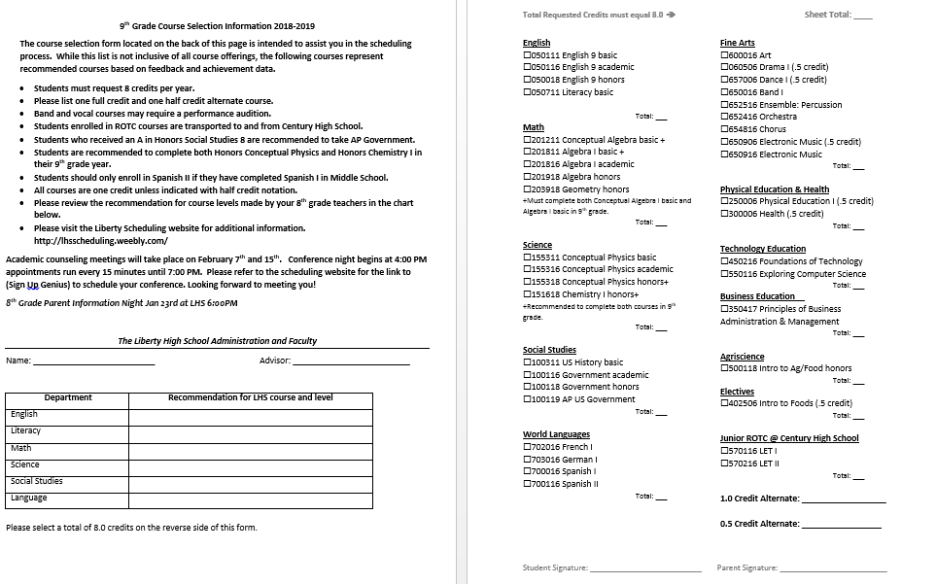
Course selection sheet
Notes:
Here is what your son/daughter brought home. Please bring this to the advisory conference. Give us a few weeks and you should be able to view in HAC.

Slide 19
Dates to Remember
Scheduling Conferences
February 7th and 15th
appointments from
4:00-6:45pm
Please check email for SignUp Genius link to schedule a conference with your student’s advisor.
Course requests are due back to LHS during your scheduling conference.
2 presentations during conference nights
(AP Potential and Internship Opportunities for High School Students)
Notes:
February 7th and 15th are scheduling conferences where parents are invited in to meet with advisors regarding their student’s course requests.
Please schedule your conference through the SignUp Genius link. Advisors are printed on students’ course requests. No advantage in scheduling for Feb 7 versus Feb 15.

Slide 20
Tips for Advisory Conferences
1. Review your student’s course requests prior to the conference, noting the teachers’ recommendations. Please consult with the 8th grade teachers regarding questions about recommendations.
2. Review your student’s academic progress in their 8th grade courses.
3. Create a list of questions for the Advisor.
4. Discuss your student’s college and career interests with them.
5. Ask for clarification- if you are unsure, please ask.

Slide 21
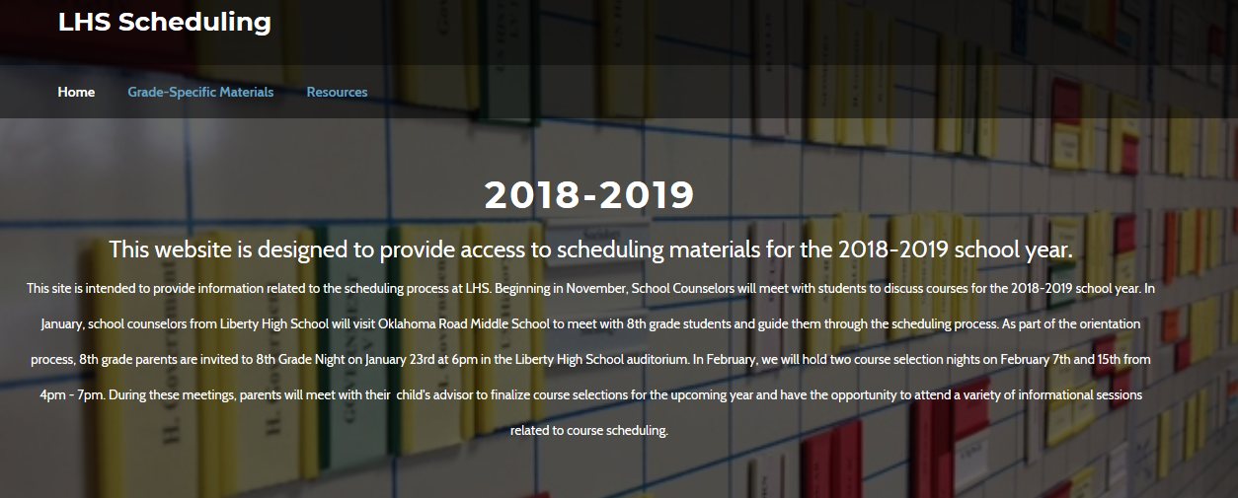
For more information…
lhsscheduling.weebly.com
Notes:
Go to webpage to demonstrate functions (Program of Studies, Grade specific information, counselor contact)

Slide 22
Transition to Liberty
ORMS field trip in April- Students receive general tour of the building and review high school information.
2. Freshmen Orientation in August- typically Thursday before school starts. Students can walk their schedule and meet their advisor. Parents attend information sessions.
3. Getting involved:
Over 30 clubs- sign ups during the first week of school
Drama
Chorus
Band
Athletics

Slide 23
Thank you!
We look forward to welcoming your family to Liberty High School!

